Slide 1
Architectural Styles for applications on cloud

Slide 2
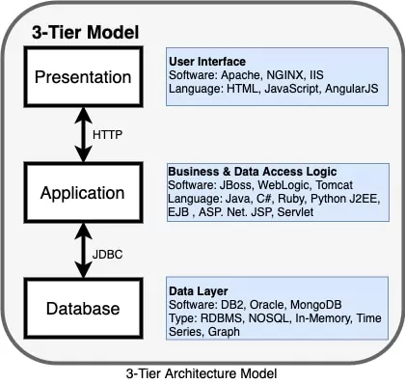
Monolithic -3tier Architecture

Slide 3
Monolithic Application
Integrated collection of software components developed as a single package.
Ex: E-Commerce Application with Search,Payment and Review and ratings.
These components accessible to user through web browser. Developer deploys it as single Application on a server. If scaling is required then you need to run multiple instances of server having that application.

Slide 4
Microservices
It builds application as a collection of autonomous services .
Each service performs a small and complete business task.
An application is the collection of loosely coupled microservices which are fine grained and use light weight protocols for communication.
Ex: E-Commerce Application now will be collection of autonomous services which run in a containerized environment.
Micro webservices- Peter Rodgers.
Does one task very well and interacts with other services.

Slide 5
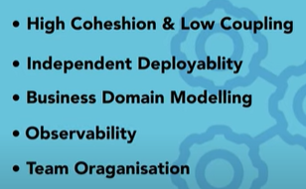
Key concepts

Slide 6
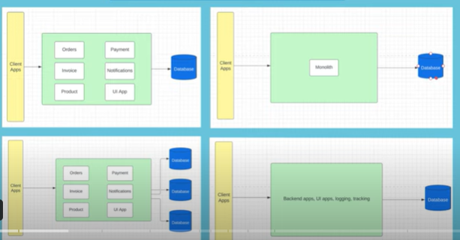
Example of monolithic application

Slide 7
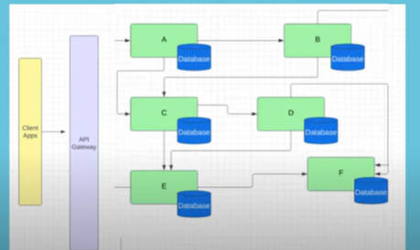
Microservices

Slide 8
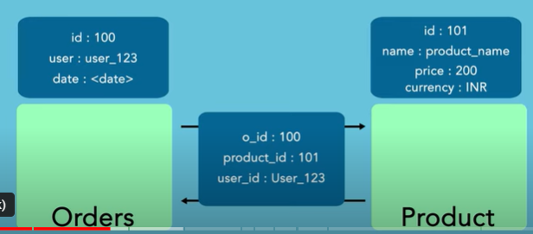
Cohesion and Coupling example
Orders microservice – everything related to orders functionality lies very close or within order microservice- cohesion
If I consider Products microservice then its dependency on orders service should be very close to zero. – Coupling
Product should not know business logic of orders or vice versa

Slide 9
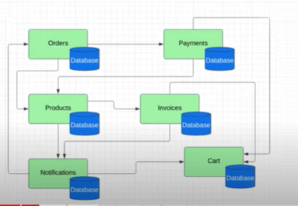
E-Commerce Application-modelled across business domains

Slide 10
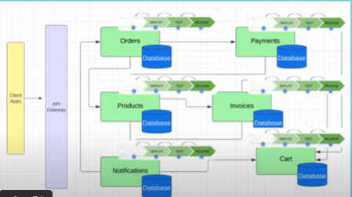
Independent deployability

Slide 11
Independent Scaling – to take many orders I can deploy multiple instances of orders microservice independent of others. Observability- Fault detection is easy Resilience – one service such as invoice is down other services are unaffected. Team Organization-Swapping of teams or members is easy

Slide 12
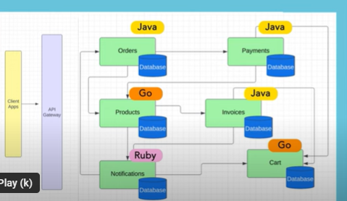
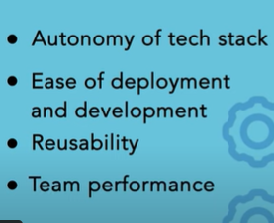
Advantages and disadvantages

Slide 13
Costly
Tech overload
Inconsistancy

Slide 14
References
https://www.youtube.com/watch?v=mgCUmdH5LNk&t=84s

